Slide 1
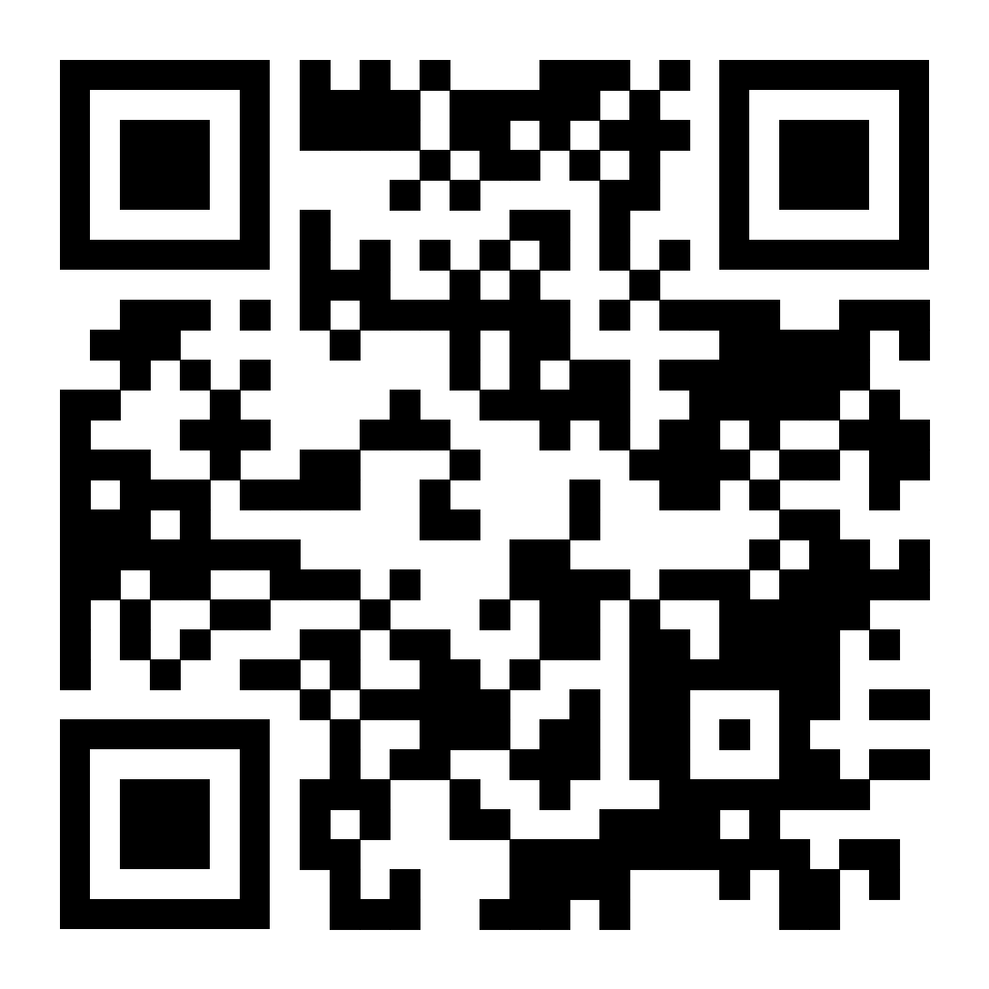
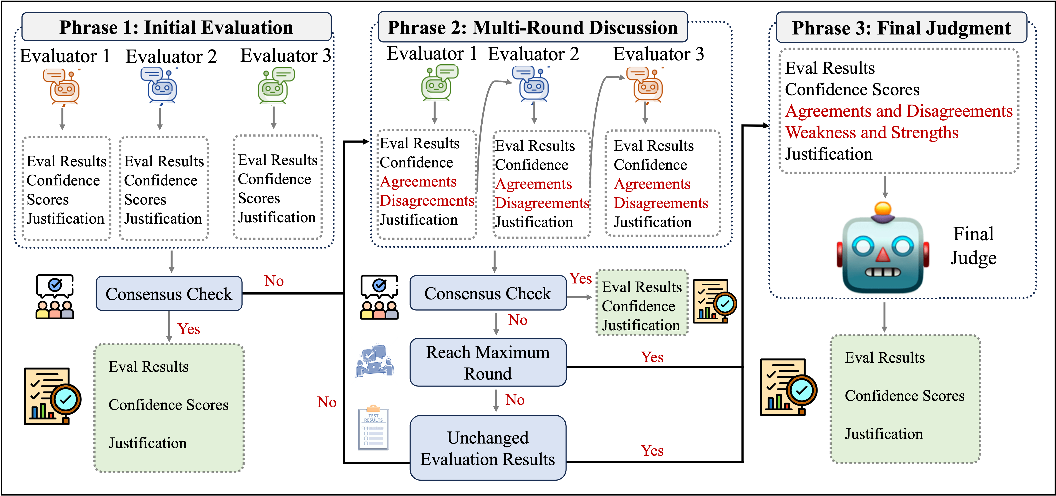
CollabEval: LLM-as-a-Judge via
Multi-Agent Collaboration
Yiyue Qian, Shinan Zhang, Yun Zhou, Haibo Ding, Diego Socolinsky , Yi Zhang

